Slide 1



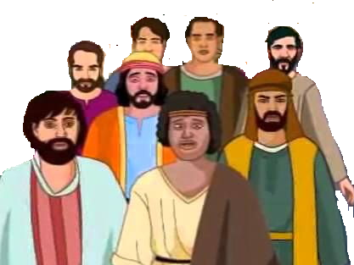

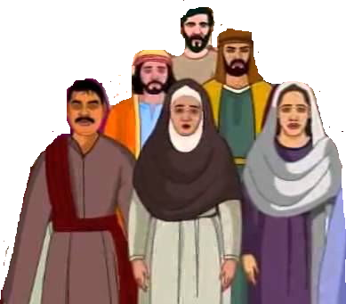
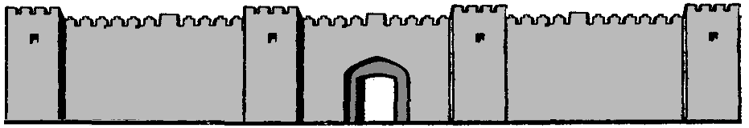
Israel
Babylonia
Daniel
Jeconiah & Kish
Jerusalem destroyed
Sheshbazzar
Esther
Ezra
Nehemiah

