Slide 1

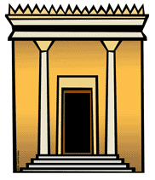

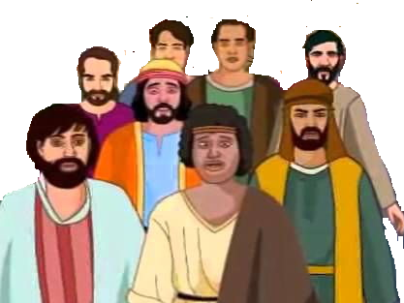
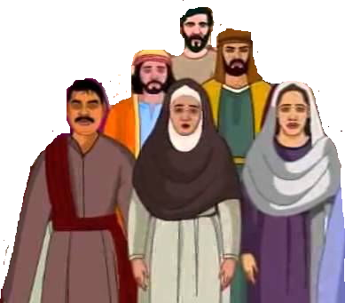
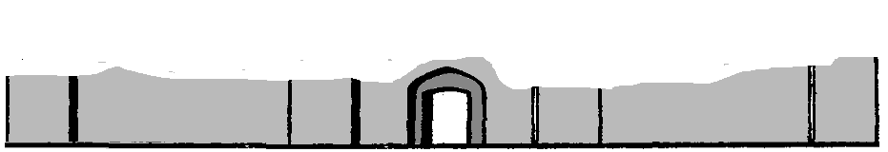
Jerusalem

Slide 2
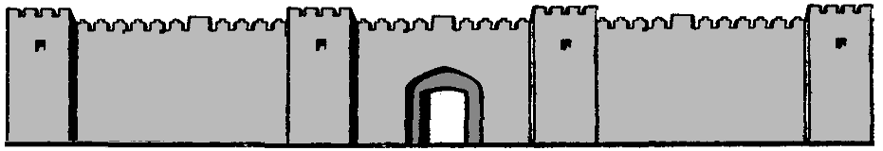
Jerusalem

Slide 3

Israel
Babylonia
Daniel
Jeconiah & Kish
Jerusalem destroyed
Sheshbazzar
Esther
Ezra
Nehemiah

