Slide 1


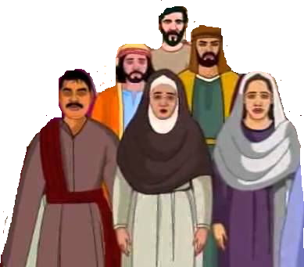
Susa

Slide 2


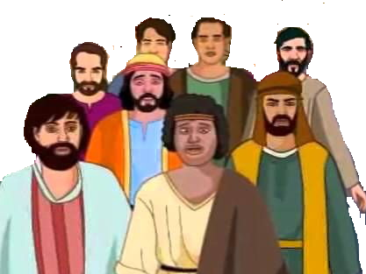
Jerusalem

Slide 3

Israel
Babylonia
Daniel
Jeconiah & Kish
Jerusalem destroyed
Sheshbazzar
Esther
Ezra
Nehemiah

