Slide 1

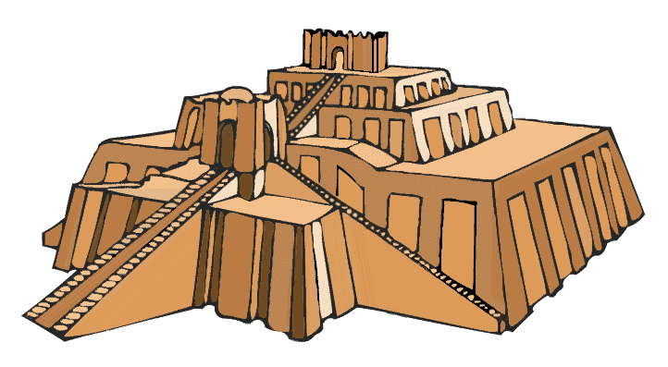
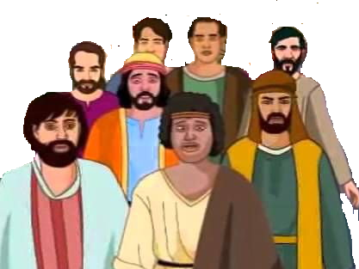

Babylonia

Slide 2


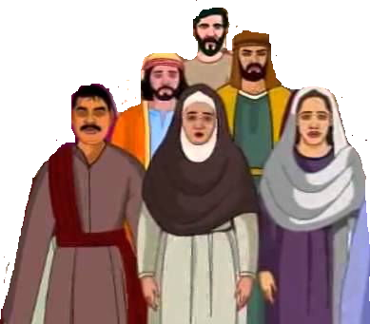
Jerusalem

Slide 3
Jerusalem

Slide 4

Israel
Babylonia
Daniel
Jeconiah & Kish
Jerusalem destroyed
Sheshbazzar
Esther
Ezra

