Slide 1


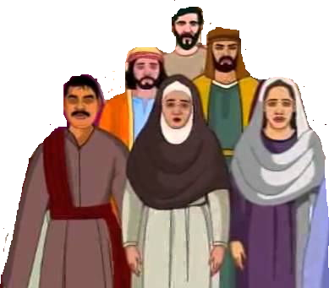
Susa

Slide 2


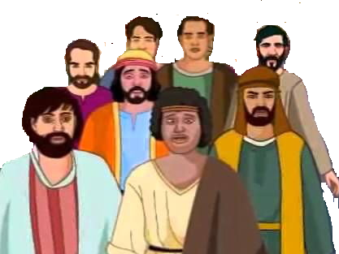

Israel
Babylonia
Daniel
Jeconiah & Kish
Jerusalem destroyed
Sheshbazzar
Esther

