Slide 1


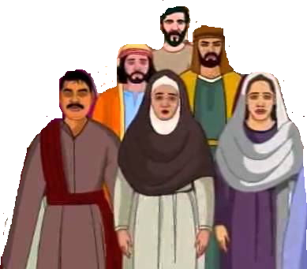

Jerusalem

Slide 2
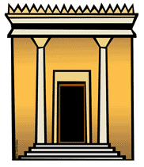
Jerusalem

Slide 3

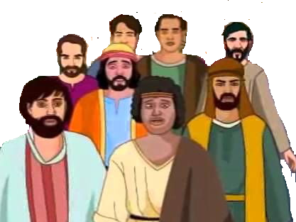
Israel
Babylonia
Daniel
Jeconiah & Kish
Jerusalem destroyed
Sheshbazzar

