Slide 1

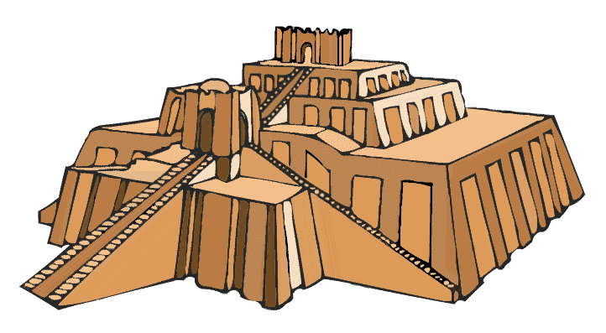
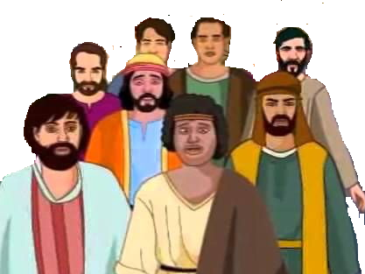
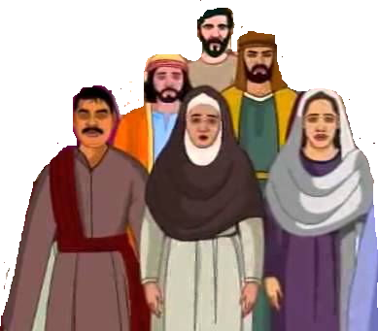

Babylon

Slide 2

Jerusalem

Slide 3

Jerusalem

Slide 4
Israel
Babylonia
Daniel
Jerusalem destroyed
Sheshbazzar

