Slide 1

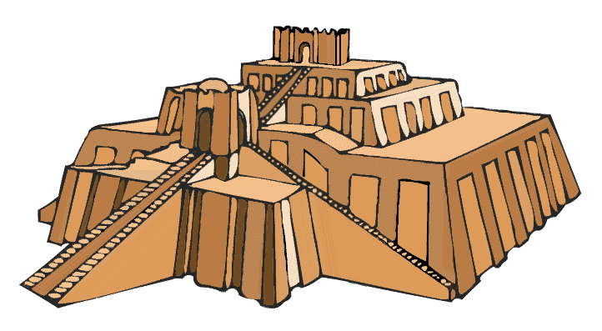
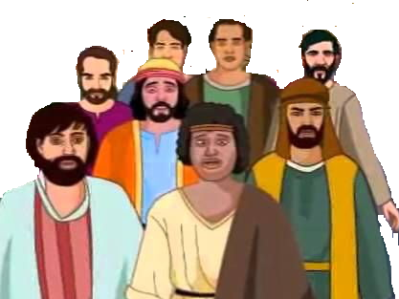

Babylon

Slide 2

Israel
Babylonia
Daniel
Jerusalem destroyed

