Slide 1

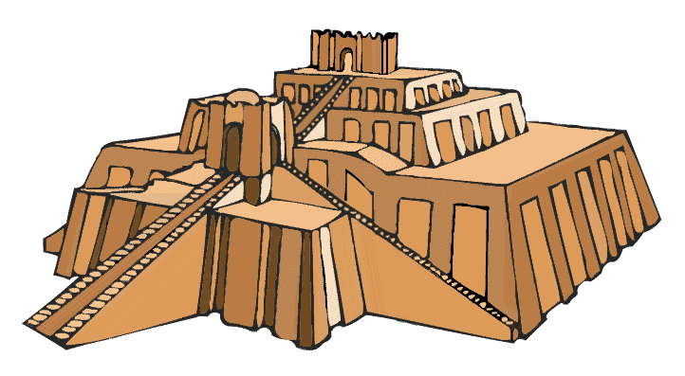
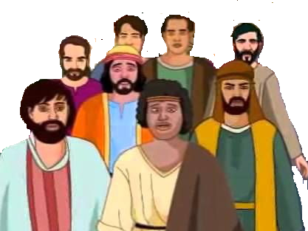

Babylon

Slide 2
Israel
Babylonia
Daniel

