Slide 1



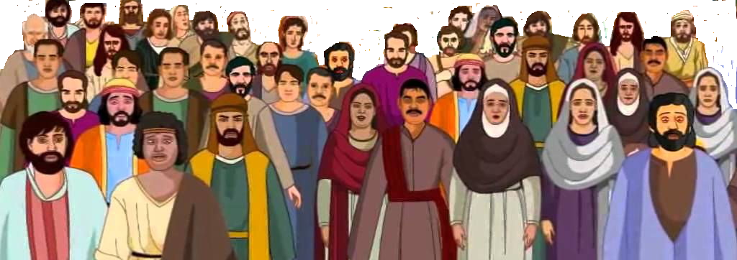

Jerusalem

Slide 2

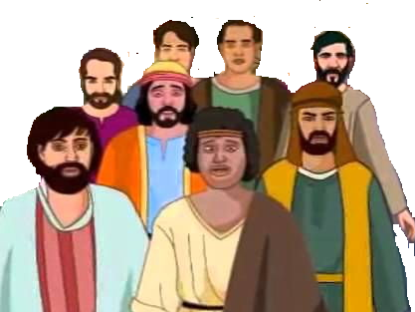
Jerusalem

Slide 3
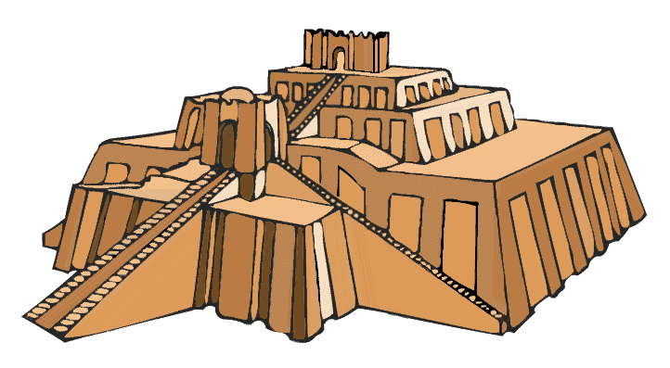

Babylon

Slide 4
Israel
Babylonia
Daniel

